Slide 1


ROOTPIXEL PRESENTS
LEVIDIO CINEMAGIC

Slide 2
CINEMATIC PROMO
TRAVEL AND HOLIDAYS

Slide 3

EASY TO CUSTOMIZE
USING ONLY POWERPOINT

Slide 4
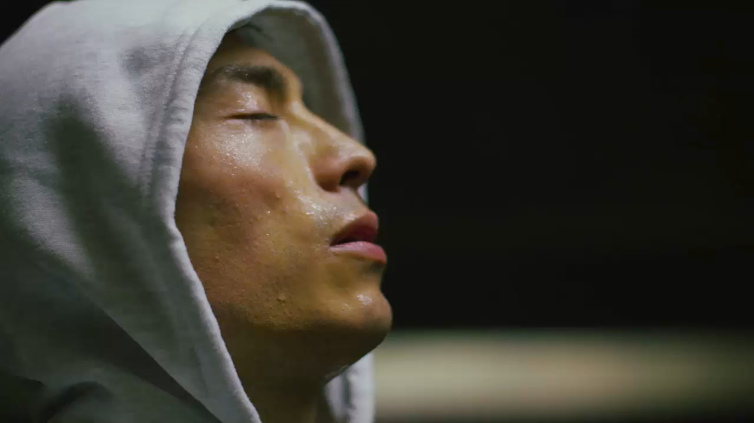
CINEMATIC
VIDEO TEMPLATE

Slide 5


BRAND NEW
CINEMATIC LOOK

Slide 6
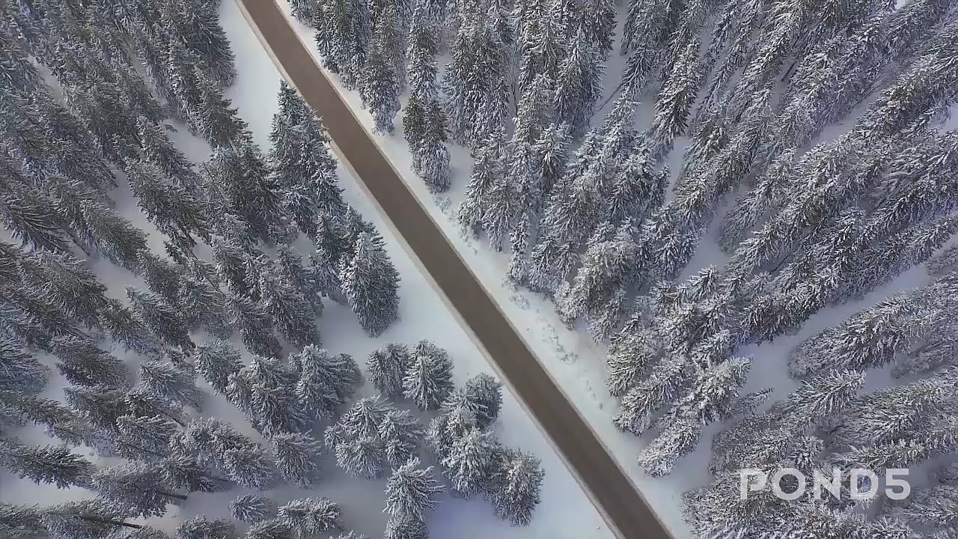
MODERN DESIGN
SIMPLE LAYOUT

Slide 7
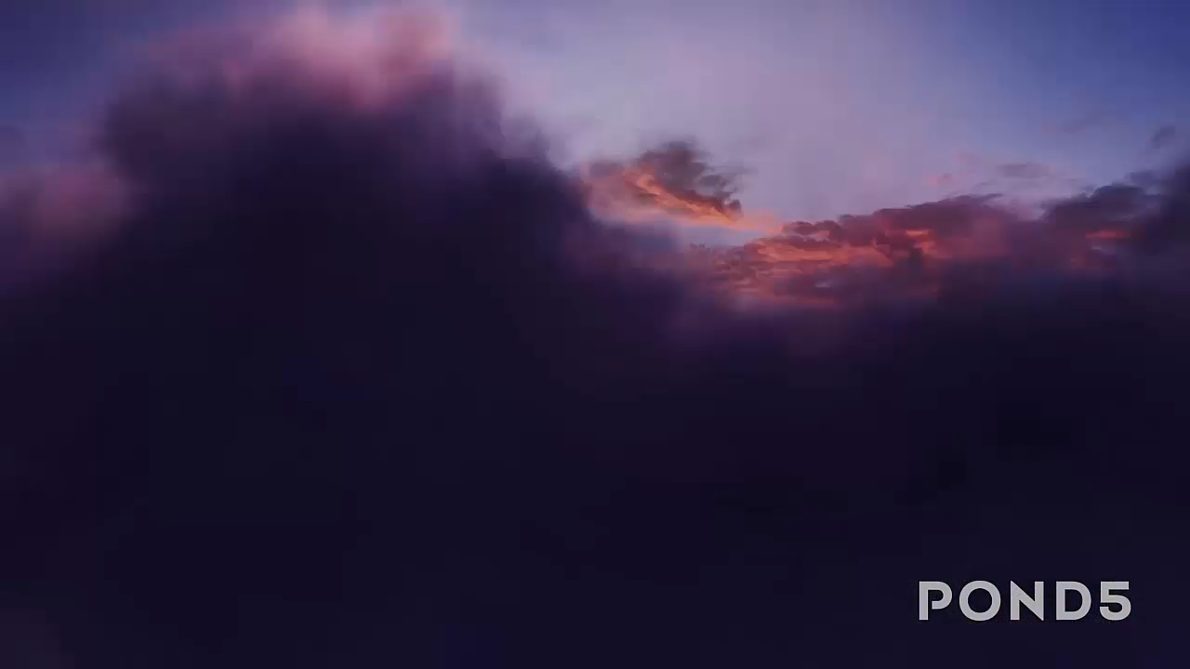
START UP VIDEO
MADE EASY

Slide 8
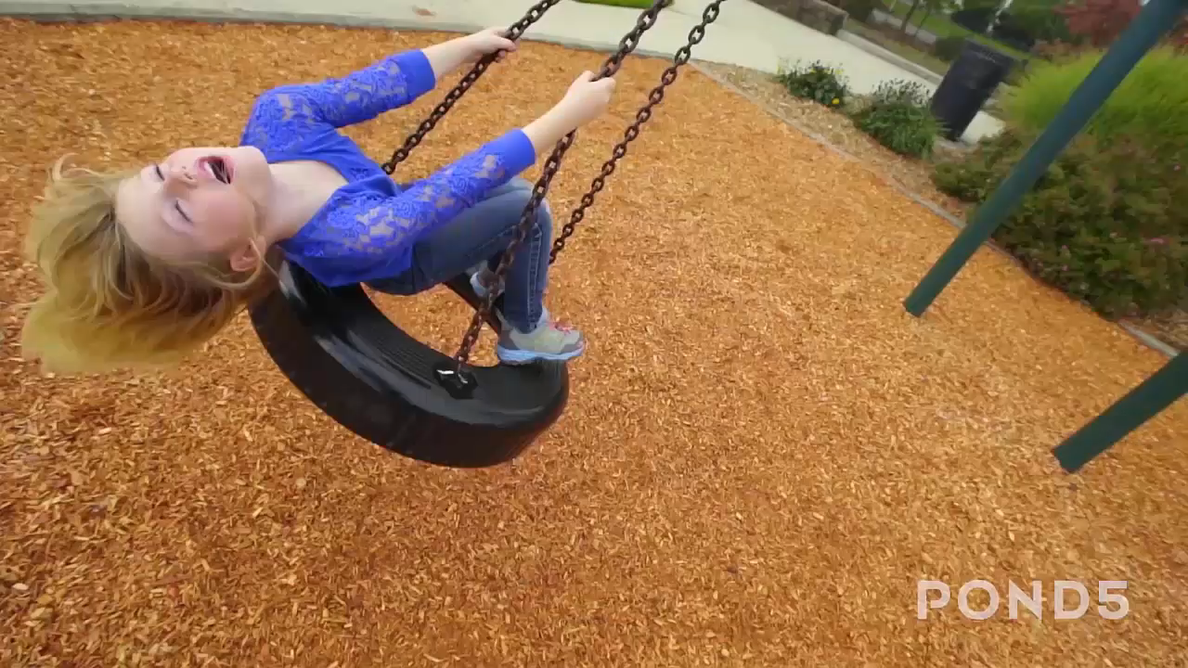
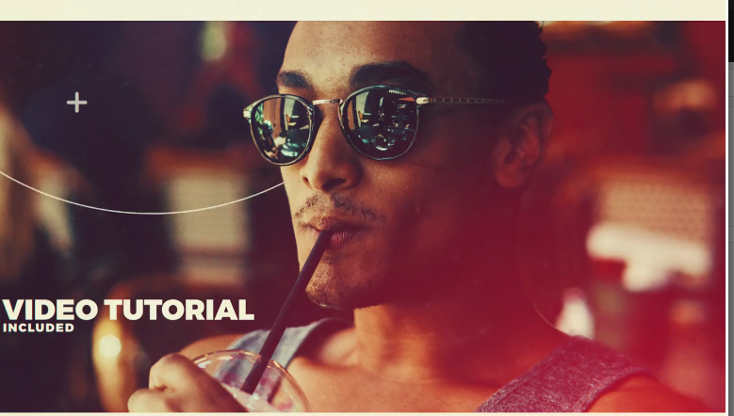
EASY TO CUSTOMIZE
TEXT AND COLOR

Slide 9

TRAVEL PROMO
CINEMATIC VIDEO

Slide 10
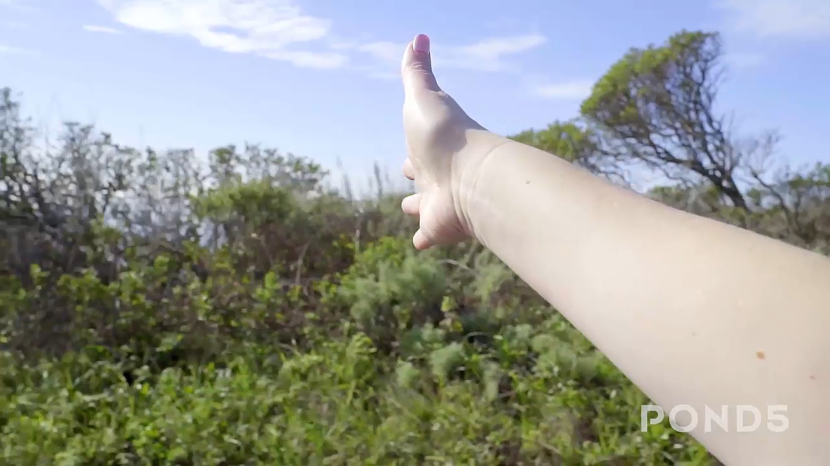
TRAVEL PROMO
USING LEVIDIO

Slide 11
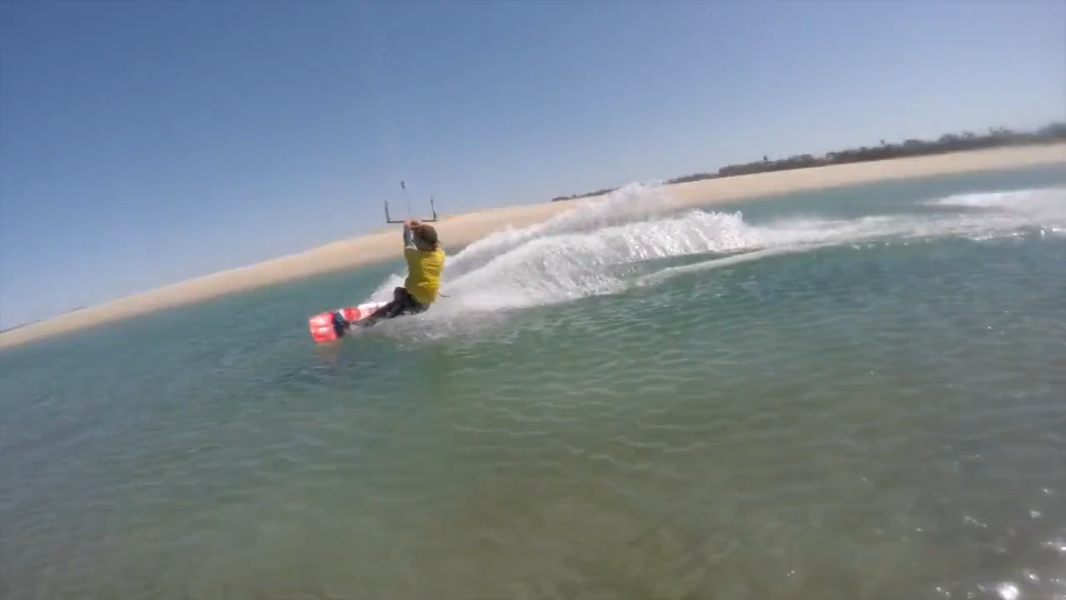
PLAN YOUR GATEWAYS
WITH CINEMATIC VIDEO
LEVIDIO VIDEO PROMO

Slide 12
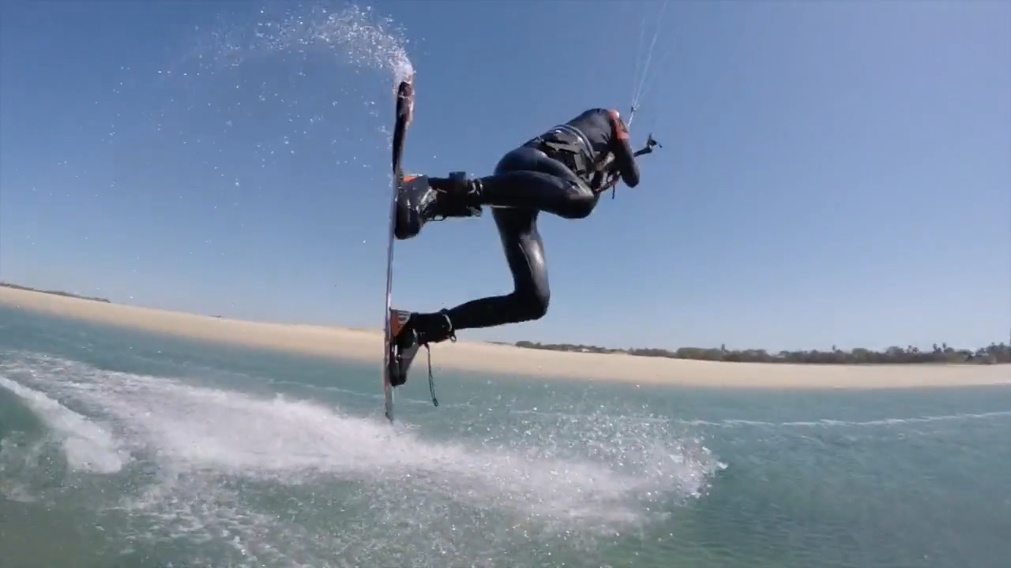
LEVIDIO
VACATIONS
PLANNER

Slide 13
GRAB IT FAST

Slide 14
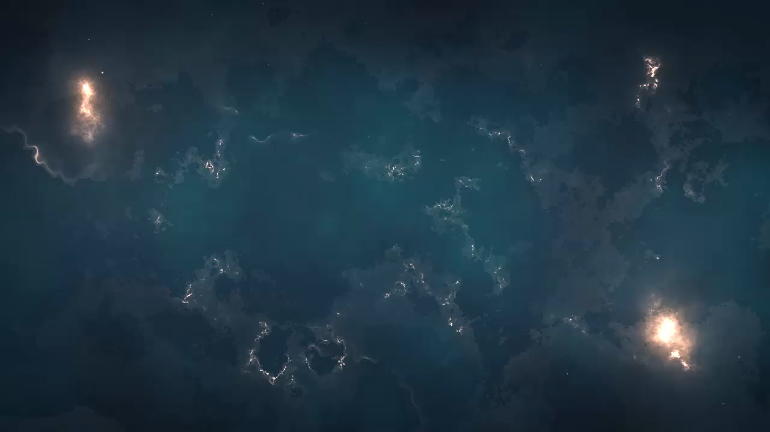




VISIT US
www.yourdomain.com
Your facebook
Your channel
Your instagram

